Slide 1
Makana
QR code placement
(Apra to create)
Donation Insights Tool
edimaudo@gmail.com

Slide 2
Makana means Gift in Hawaiian

Slide 3
Donation Overview & Insights

Slide 4
The Challenge
5
$1006
Recently, your organization expanded, attracting a new pool of potential donors. With this expansion, the vice president of advancement has tasked your team with developing data-driven fundraising portfolios for the new prospect pool.
This challenge is not just about identifying prospects but about strategically organizing them into portfolios that maximize fundraising efficiency and impact.
CRM Interaction Types
2025 Avg. Gift Amount
10
4
# of Years used in analysis
# of Datasets

Slide 5
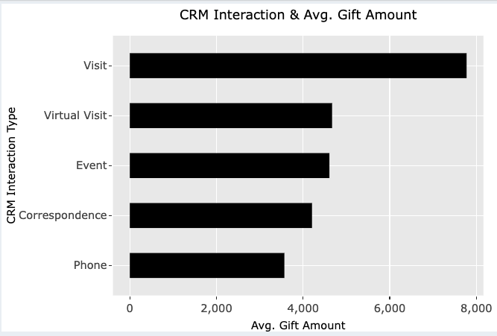
Visits are aligned with higher gift amounts
Opportunities to improve donation approach with respect to virtual visits and event approaches

Slide 6
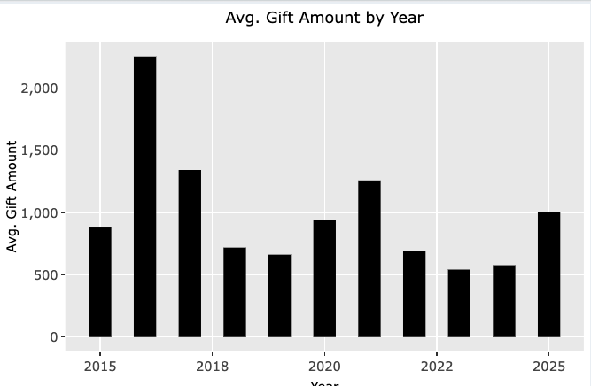
2016 saw the highest average gift amount of $2260
2025 is showing a better average gift amount compared to the last 3 years
Opportunity to have a consistent gift amount year after year

Slide 7
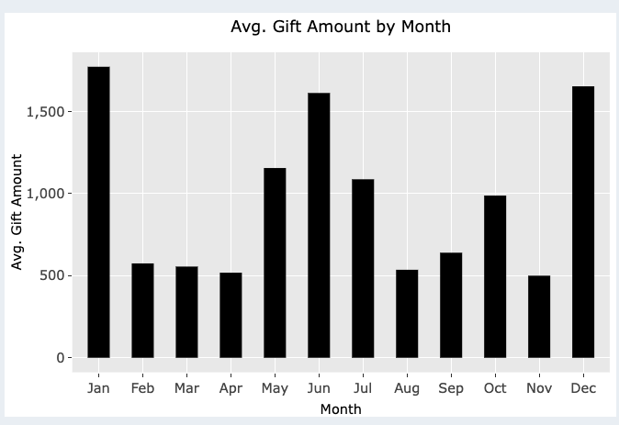
January, June and December are pivotal gift giving months
Opportunity to drive more gift giving in low periods like February - April

Slide 8
Donor Portfolio

Slide 9
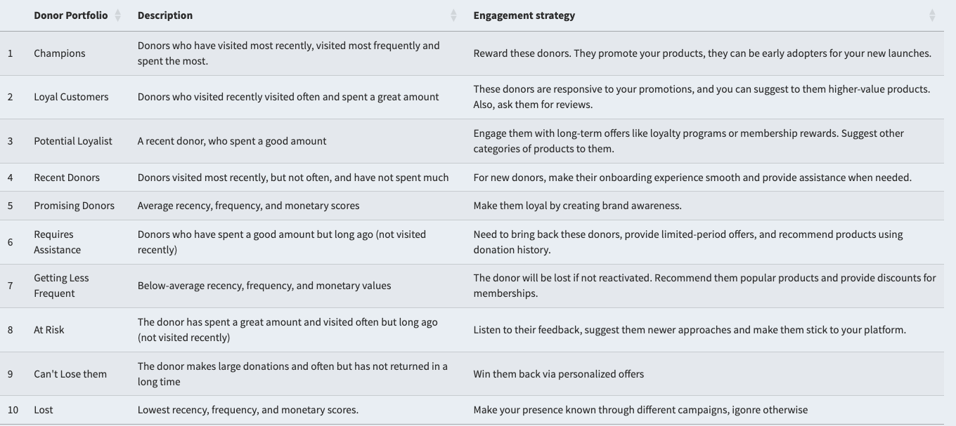
Leverages RFM Analysis to segment donors using R
Highlights engagement strategy for each donor group

Slide 10
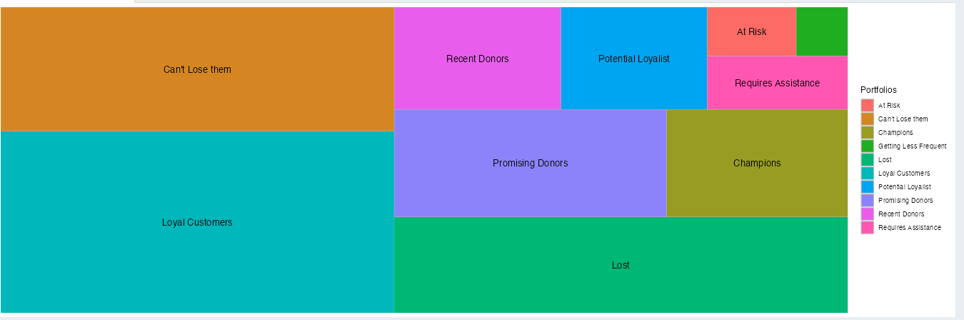
Highlights the different donor segments
Opportunities to improve engagement with Promising donors, Can’t Lose Them, Loyal Customers
Have to reduce the amount of Lost donors

Slide 11
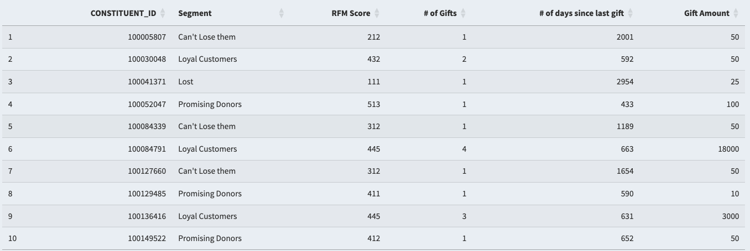
Constituents assigned to donor segments
Can leverage the donor segment and drive tailored engagement strategy
Use donor segments for donation opportunities
forecasting future gifts
Predicting gift amounts

Slide 12
Donation Prediction

Slide 13
Opportunities
Leverage data analytics approaches to
Understand what what future donation amount could look like
Based on donation attributes see what a constituent could potential donate
This is powered by core datasets and donor portfolio
Solution
Monthly Gift Forecast to see what the monthly donation amount would be
Gift Amount Prediction using donation attributes

Slide 14
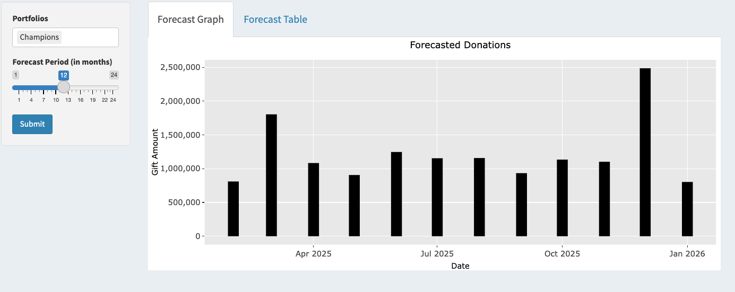
Predicts monthly future gift donations using gift dataset
Uses ARIMA model
Gives the ability to look 2 years into the future for potential donation amounts

Slide 15
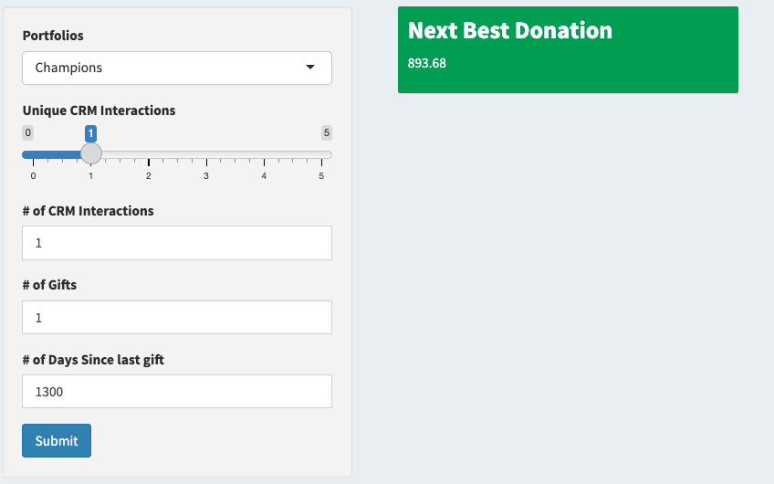
Provides the ability to generate a donation amount based on donation attributes. Also uses the donor segmentation
Uses xgboost machine learning model for prediction
Could be used as part of the engagement strategy to create customized donation amounts for constituents

Slide 16
Next Steps

Slide 17
Build out weekly, monthly and yearly insights using donation KPIs
Connect donor segment data to CRM
Detailed dive into video communication opportunities
Refine forecasting and machine learning models

Slide 18
Appendix

Slide 19
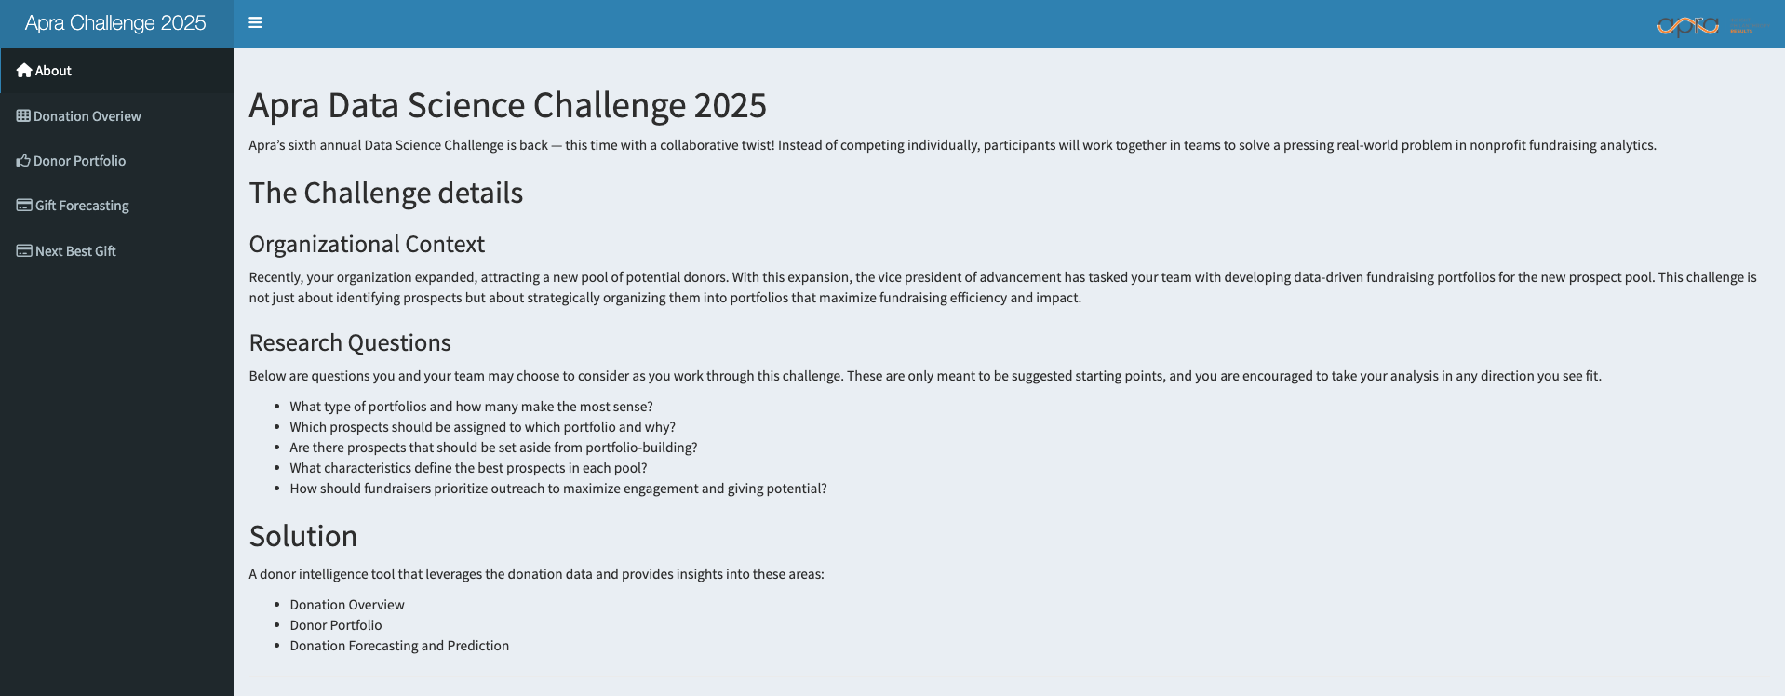
About Section

Slide 20
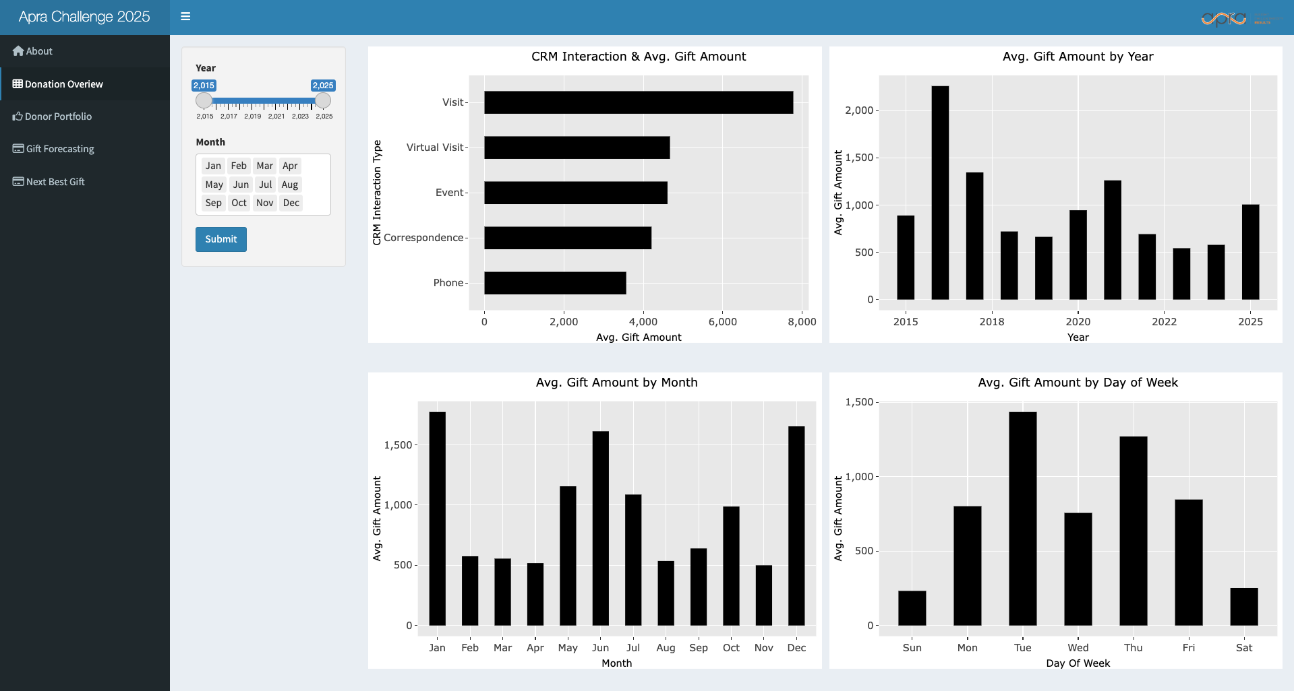
Donation Overview Section

Slide 21
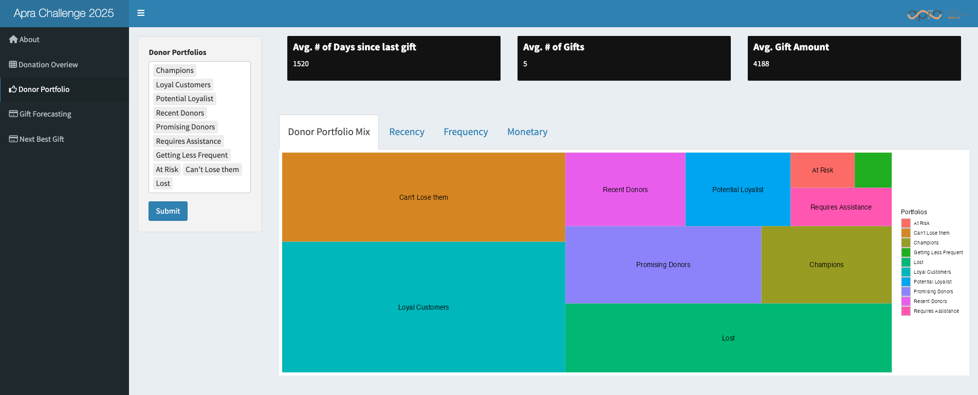
Donor Portfolio Section

Slide 22
Donor Portfolio Section

Slide 23
Donor Portfolio Section

Slide 24
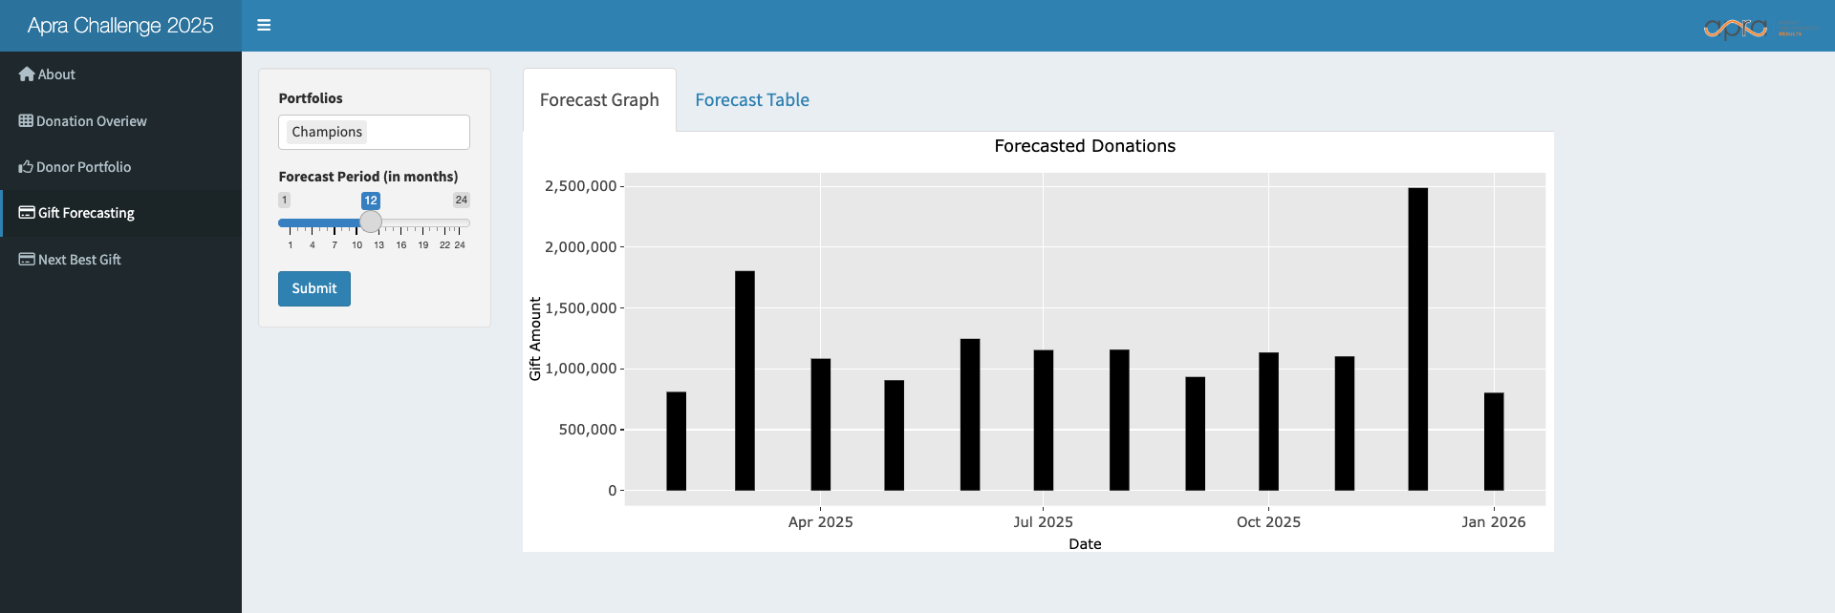
Gift Forecasting Section

Slide 25
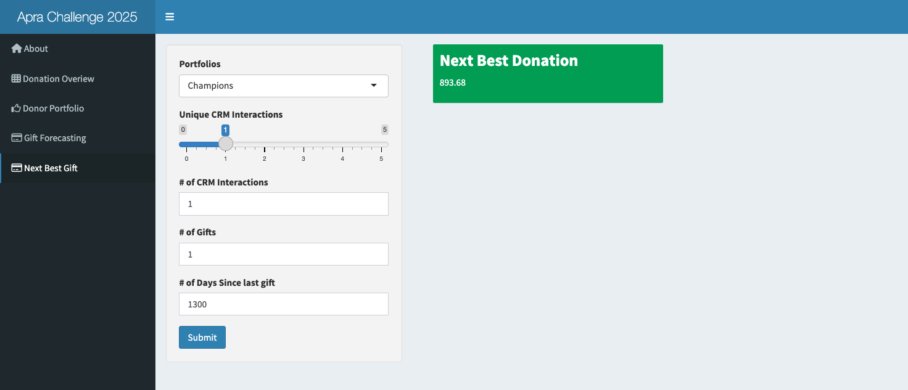
Gift Prediction Section

